Slide 1


CHAIRMEN AND NON-EXECUTIVE DIRECTORS’ REMUNERATION
THE HIGH PAY CENTRE
29th April 2013

Slide 2
CHAIRMEN AND NON-EXECUTIVE DIRECTORS’ REMUNERATION
AGENDA
Survey results: remuneration - Cliff Weight
  How much is a Chairman paid?
  How much is a Non-Executive Director paid?
  The duties, scope and influence of a NED
What is an effective Non-Executive Director? - Ken Brotherston
  What we look for when recruiting NEDs
  NEDs influence on company culture, morals and business ethics
Question and Answer Session
  Panel Debate with Q&A
Seminar ends at 7pm, followed by drinks.

Slide 3
LIFE IN THE
BOARDROOM
2013 CHAIRMAN & NON-EXECUTIVE DIRECTOR SURVEY
Chairmen and NEDs Remuneration
Survey Results
Cliff Weight
Director
MM&K

Slide 4
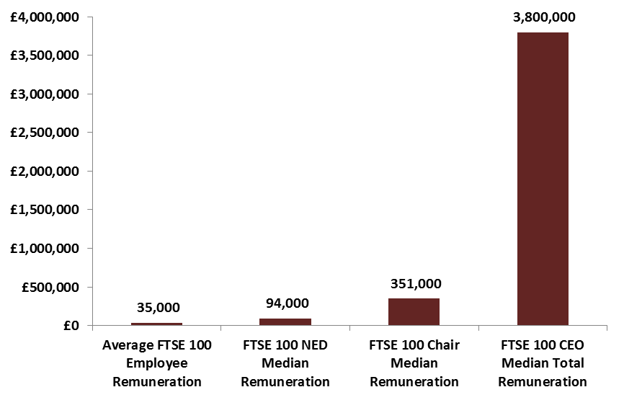
Is the Chairman really only worth 9% of the CEO?

Slide 5
The Roles of the Chairman and the CEO
The UK Corporate Governance Code clearly differentiates between the running of the company’s business and the running of the Board.
The Chairman leads the Board
The Chairman’s direct reports are the Chief Executive and the Company Secretary.
The Chief Executive is accountable and reports to the Board and is responsible for running the group’s business.
Notes:
The UK Corporate Governance Code clearly differentiates between the running of the company’s business and the running of the Board.
The Chief Executive is responsible for the following, within the authority limits delegated to him/her by the Board:
Business Strategy and Management
Investment and Financing
Risk Management and Controls
Board Committees
Communication
Other including: setting group HR policies, including management development and succession planning for the senior executive team and approving the appointment and termination of employment of members of that team.

Slide 6
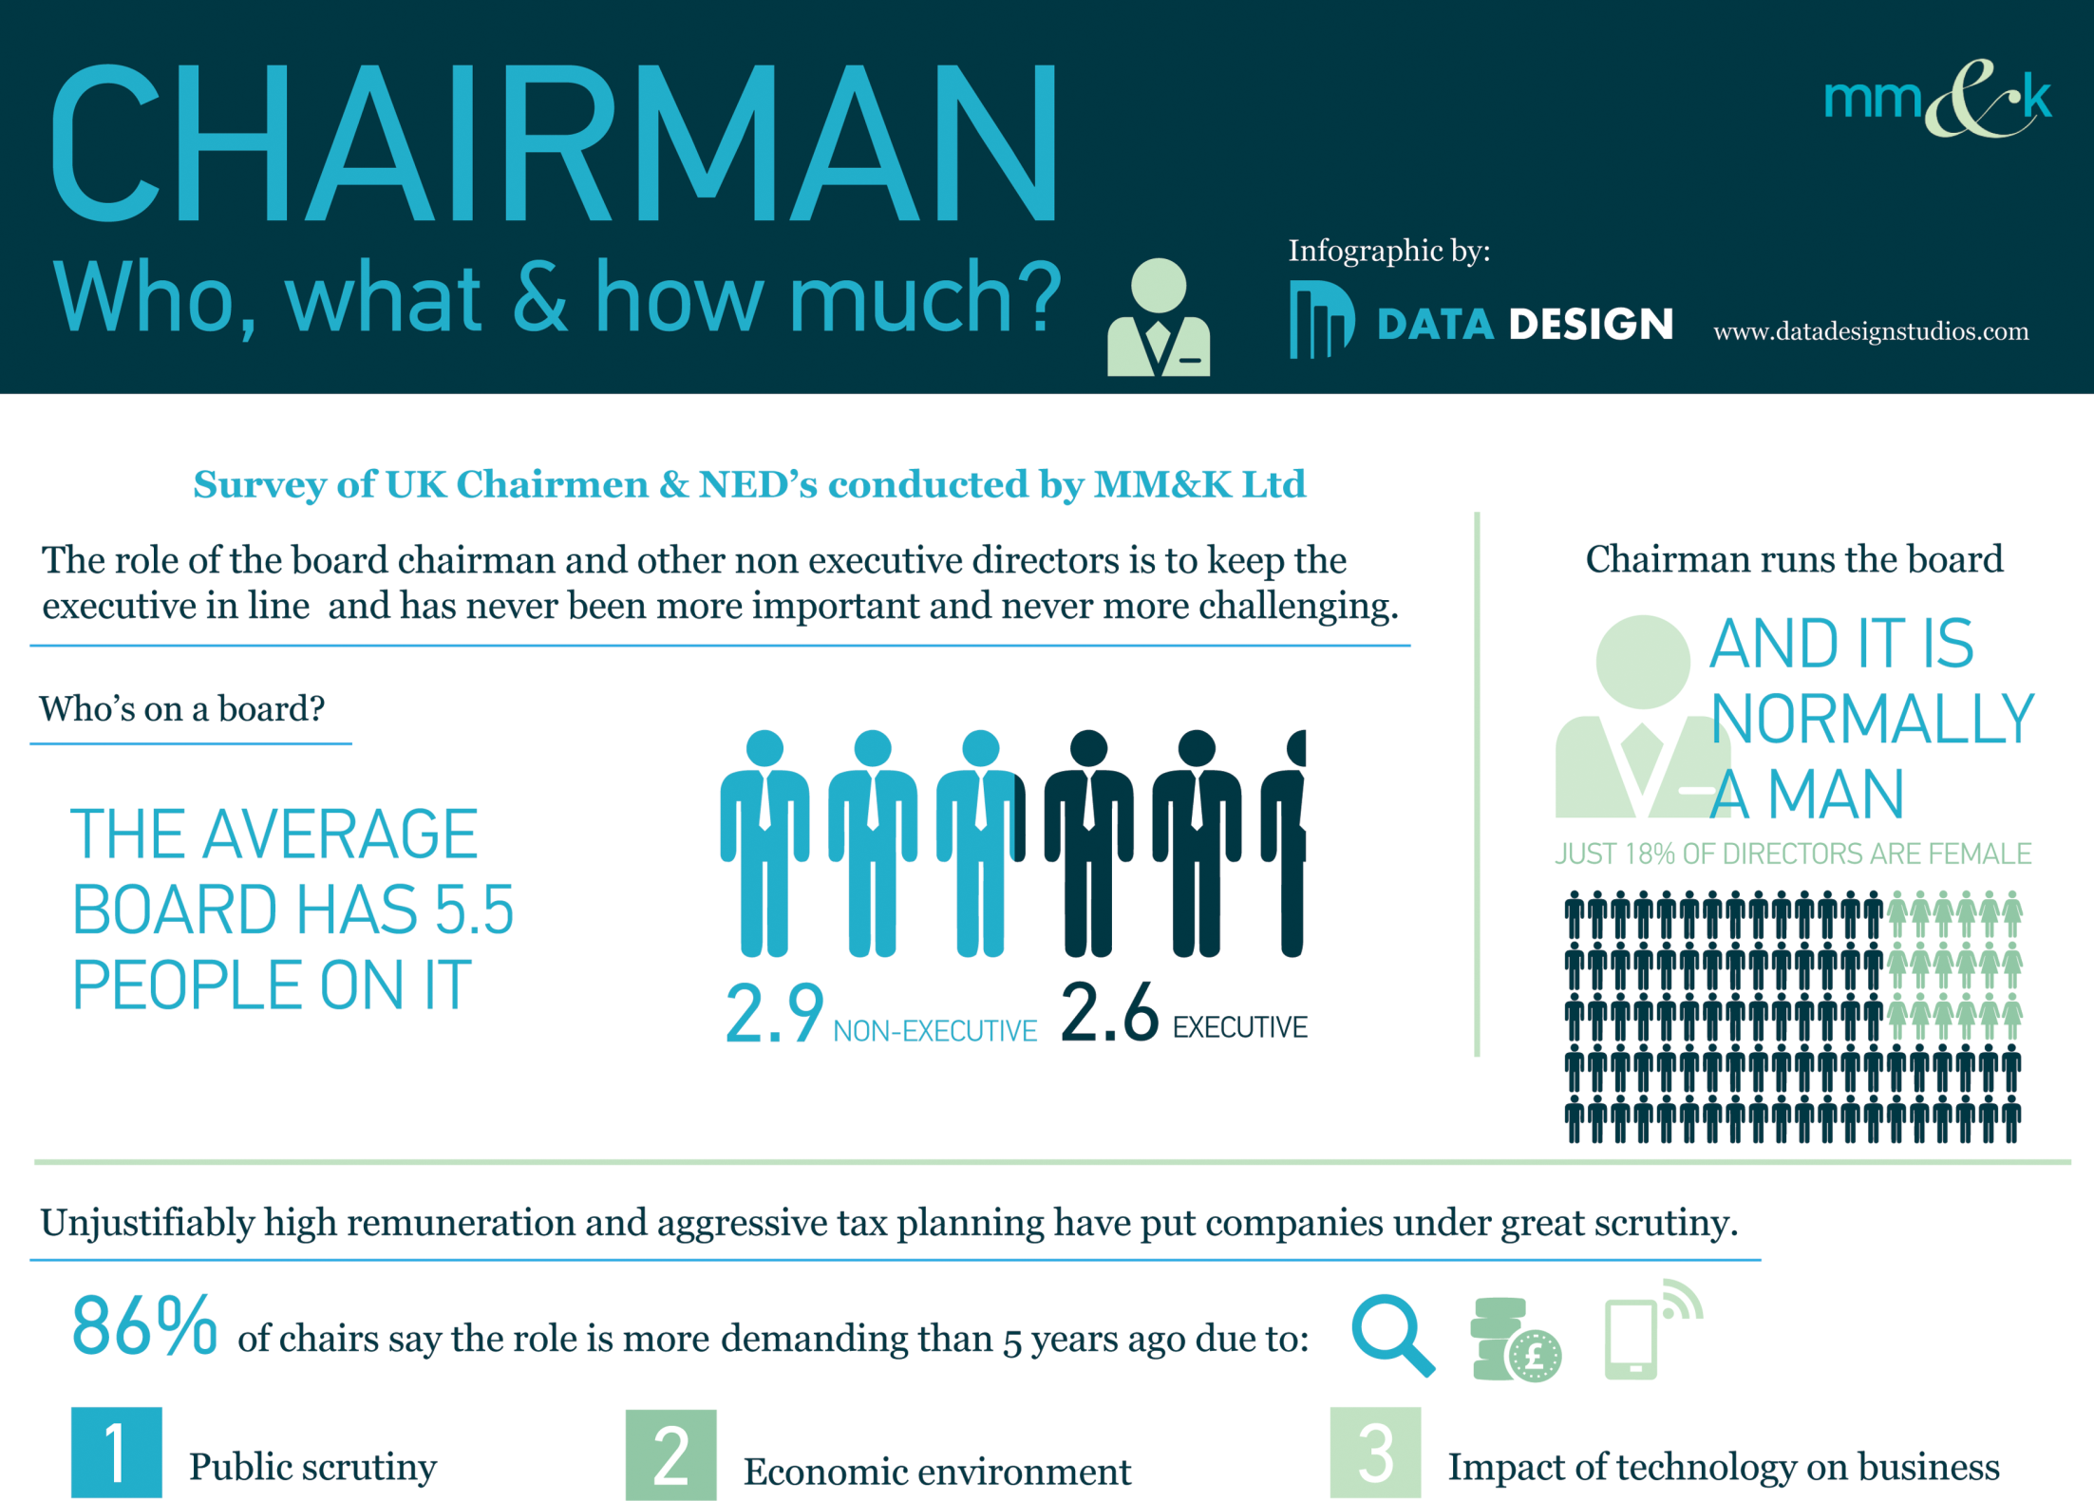

Slide 7
Chairman Role
According to the UK Corporate Governance Code, a Chairman is responsible for:
Leadership of the Board, ensuring its effectiveness on all aspects of its role and setting its agenda;
Ensuring that the directors receive accurate, timely and clear information;
Ensuring effective communication with shareholders;
Facilitating the effective contribution of Non-Executive Directors and ensuring constructive relations between executive and Non-Executive Directors, and
Acting on the results of board performance evaluation by recognising the strengths and addressing the weaknesses of the Board and, where appropriate, proposing new members be appointed to the Board or seeking the resignation of directors.
Notes:
The UK Corporate Governance Code clearly differentiates between the running of the company’s business and the running of the Board.
The Chief Executive is responsible for the following, within the authority limits delegated to him/her by the Board:
Business Strategy and Management
Investment and Financing
Risk Management and Controls
Board Committees
Communication
Other including: setting group HR policies, including management development and succession planning for the senior executive team and approving the appointment and termination of employment of members of that team.

Slide 8
Time required

Slide 9
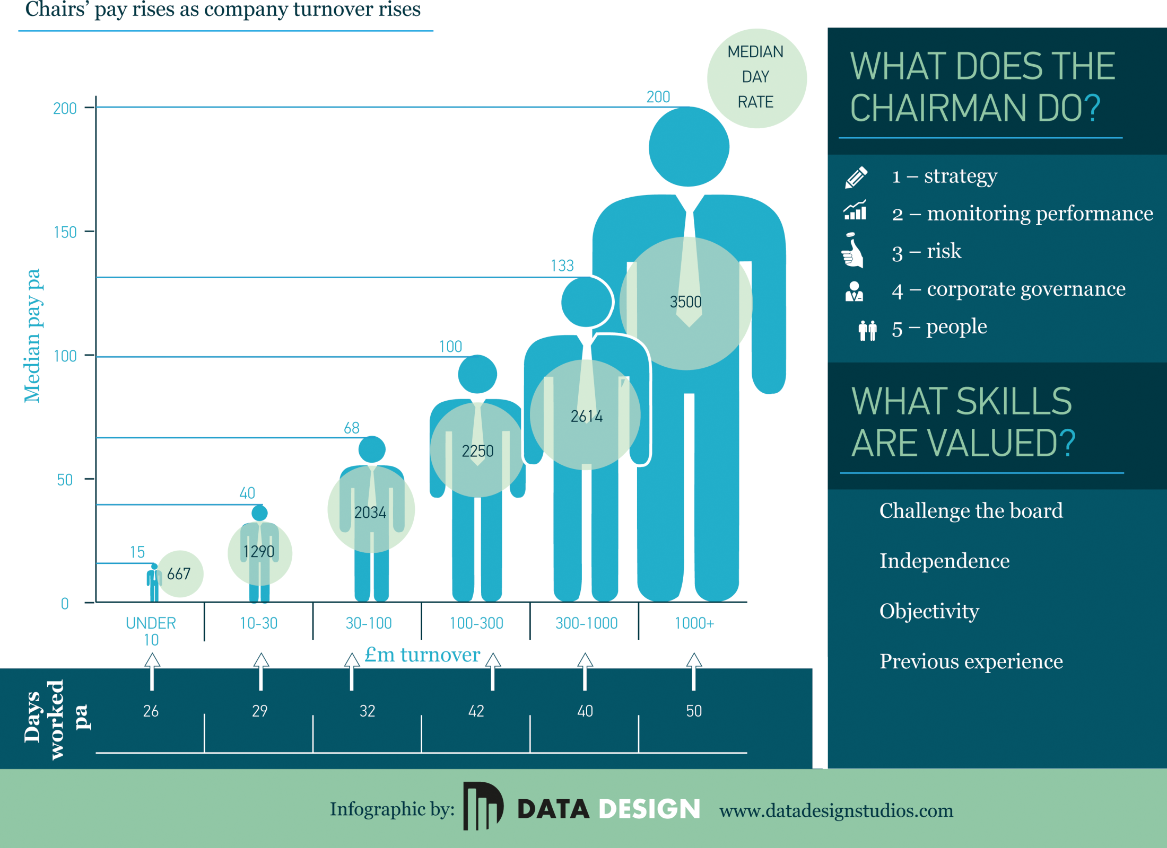

Slide 10
FTSE 100 Chairman Fees
COMPANY | TOTAL FEES | SURNAME | GENDER
Standard Chartered plc | 1,126,132 | Peace | Male
Barclays plc | 750,000 | Agius | Male
BP plc | 750,000 | Svanberg | Male
Royal Bank of Scotland Group plc | 750,000 | Hampton | Male
International Consolidated Airlines | 727,112 | Romero | Male
BAE Systems plc | 725,000 | Olver | Male
BG Group plc | 725,000 | Wilson | Male
Lloyds Banking Group plc | 713,000 | Bischoff | Male
BHP Billiton plc | 700,347 | Nasser | Male
Rio Tinto plc | 682,075 | du Plessis | Male
GlaxoSmithKline plc | 675,000 | Gent | Male
Royal Dutch Shell plc | 667,841 | Ollila | Male
Anglo American plc | 650,000 | Parker | Male
BT Group plc | 650,000 | Rake | Male
British American Tobacco plc | 592,500 | Burrows | Male
Reed Elsevier plc | 550,000 | Habgood | Male
Unilever plc | 530,099 | Treschow | Male
Tesco plc | 501,000 | Reid | Male
Diageo plc | 500,000 | Humer | Male
Eurasian Natural Resources Corp plc | 500,000 | Sittard | Male
Pearson plc | 500,000 | Moreno | Male
Prudential plc | 500,000 | McGrath | Male
Data source Manifest

Slide 11
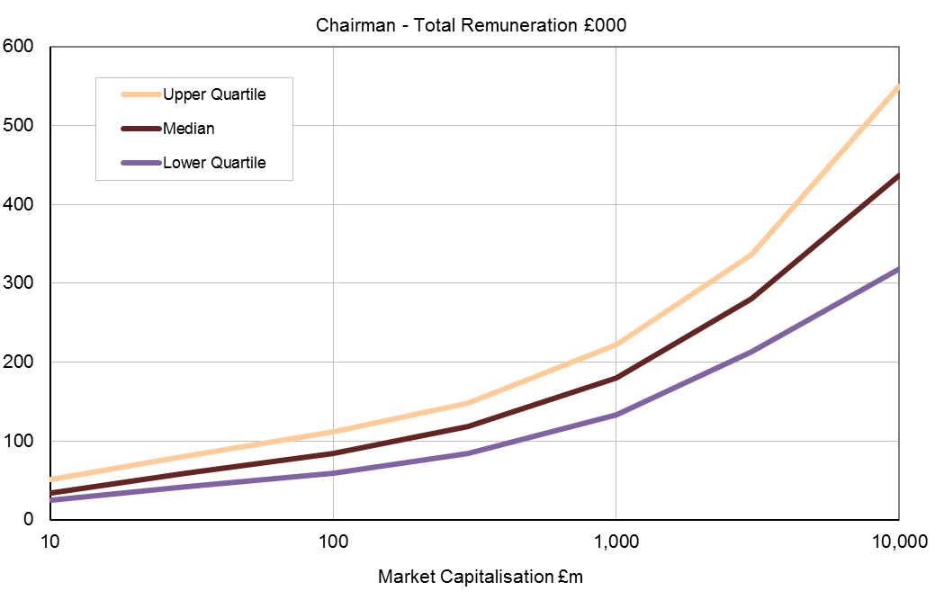
Chairman’s Remuneration – Quoted and AIM companies.
Source: MM&K/Manifest survey

Slide 12
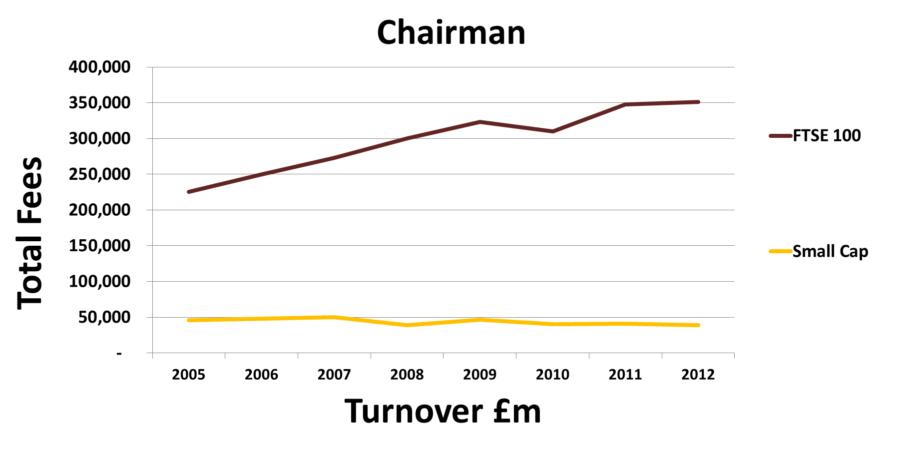
Fees Increases - FTSE 100 vs Small Cap

Slide 13
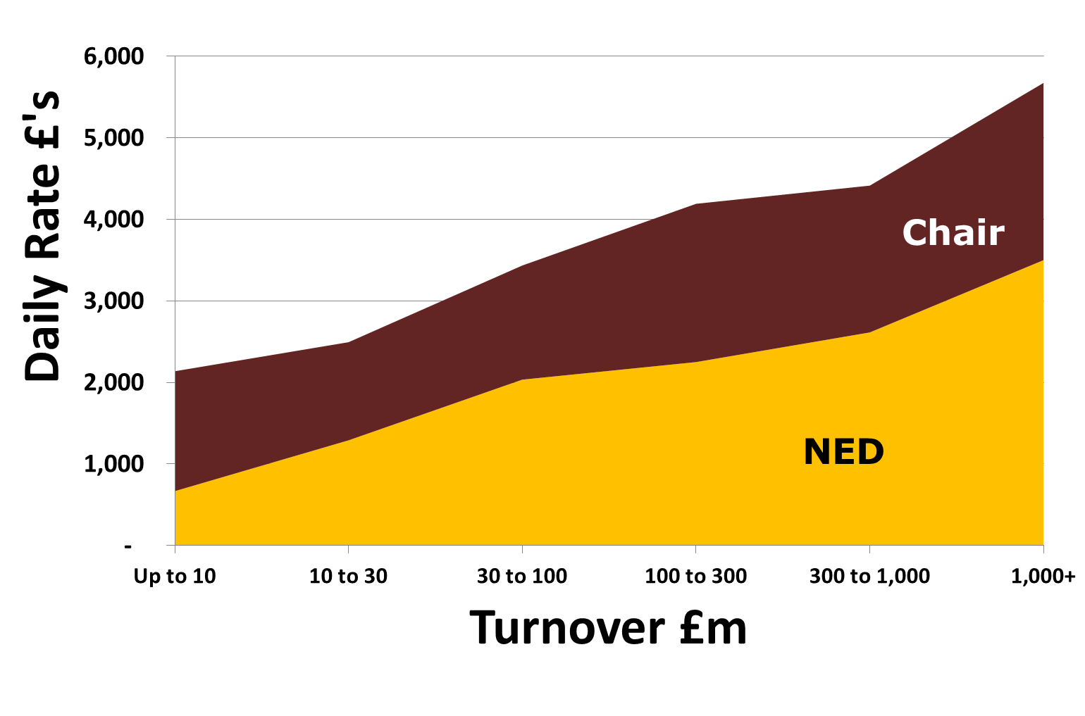
Daily Rates in £’s (Median) – Listed

Slide 14
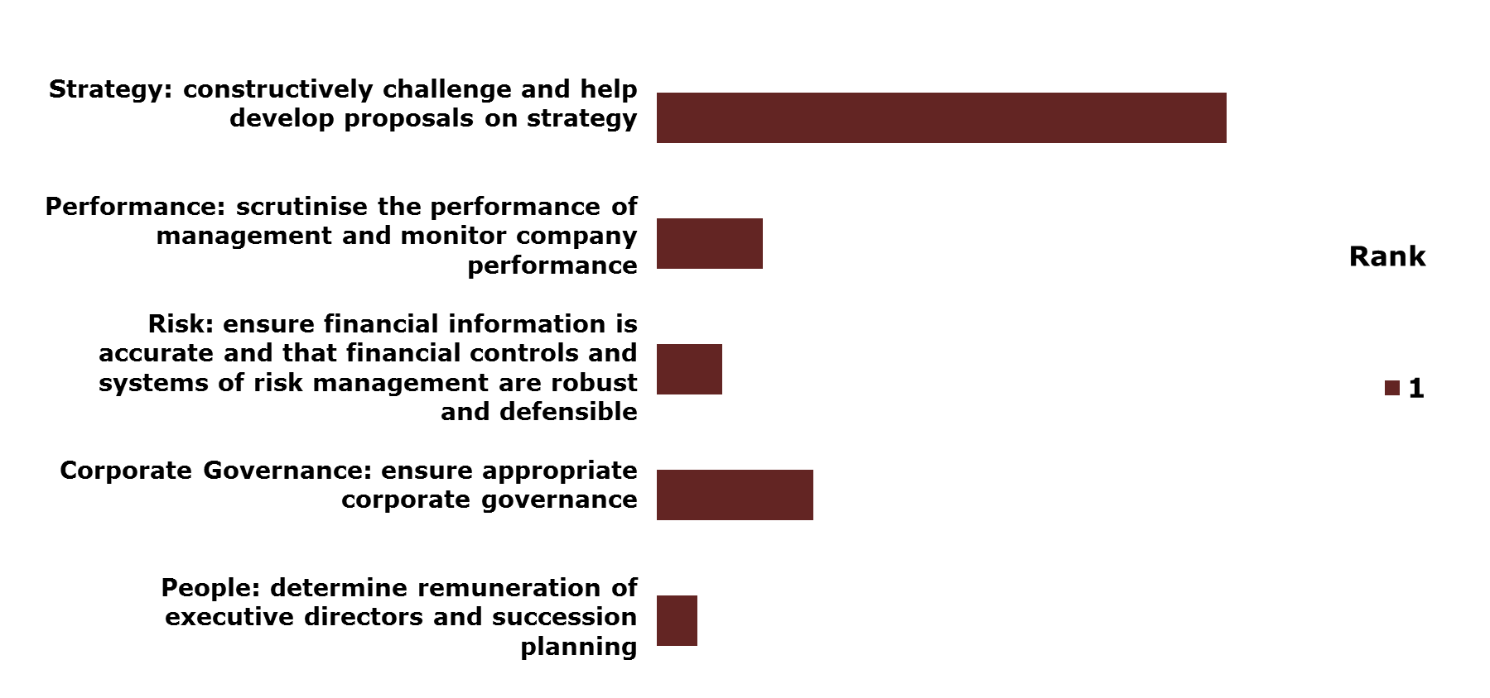
NED responsibilities ranked in order of importance

Slide 15
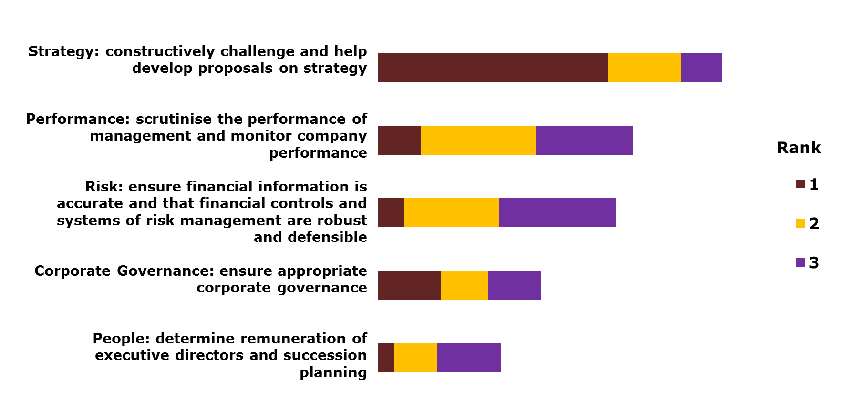
NED responsibilities ranked in order of importance

Slide 16
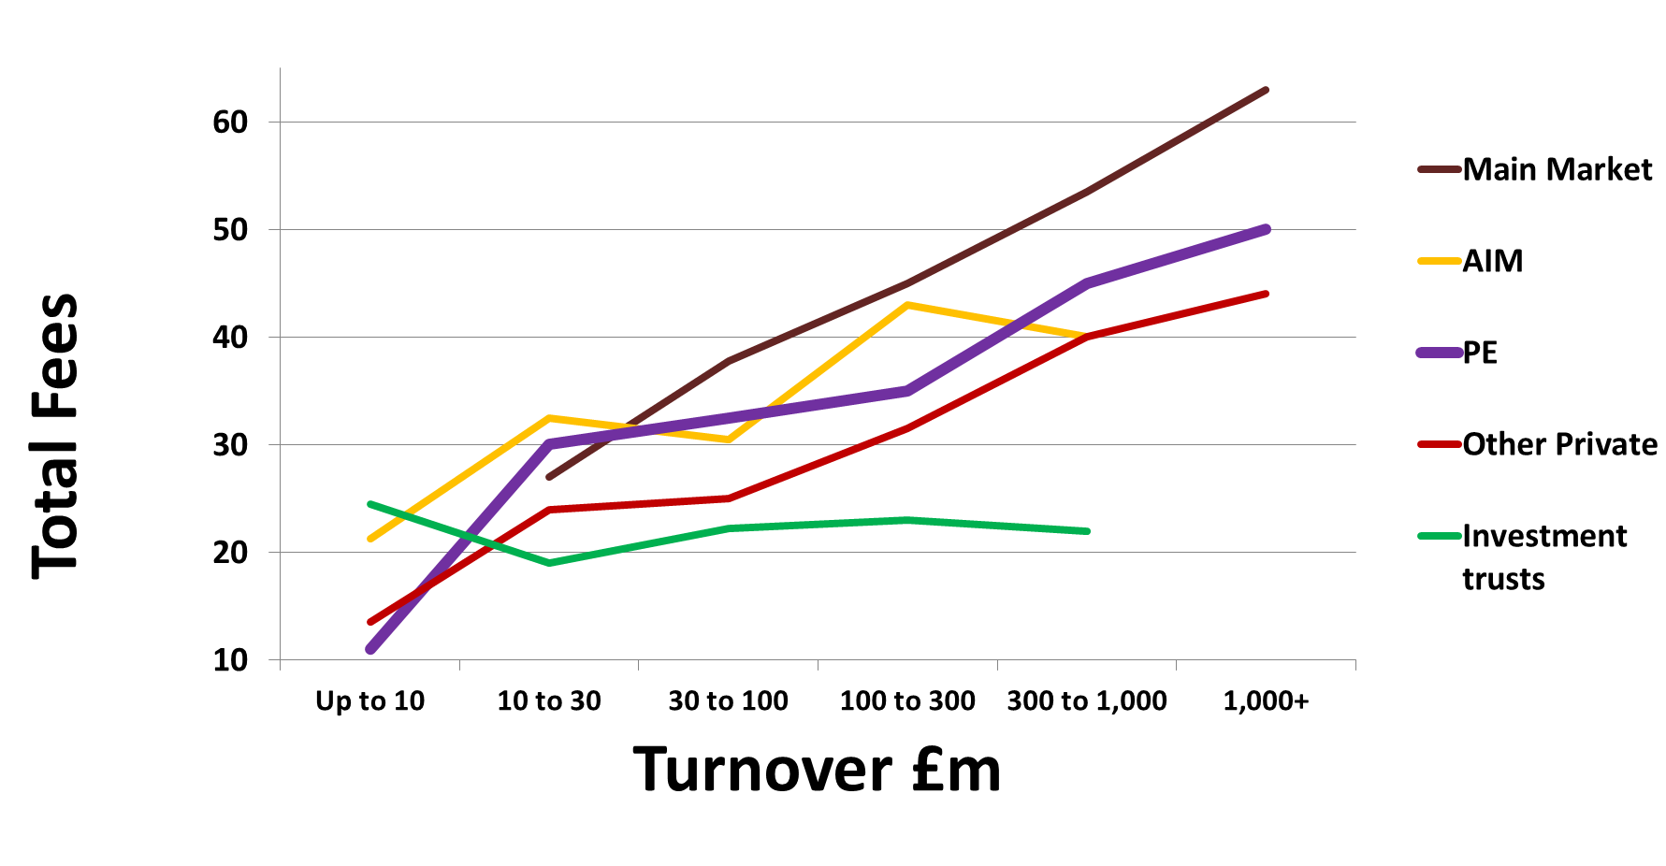
NEDs – Fees £ (Median)

Slide 17



Equity Based Remuneration
Share Ownership
Fees in Options
Payment of part of fees in shares
  Huge variety of approaches
  Debate: Alignment>>Skin in Game>>Incentive>> Independence

Slide 18
SUMMARY
Chairs paid more than NEDs
- FTSE 100 4x
- Small Cap 2x
FTSE 100 Chairs paid 9% of CEO
Performance Related Pay does not apply to Chairmen, except for a few special cases
Most attention is focussed on Executive Directors’ Remuneration

Slide 19
Ken Brotherston
Executive Chairman
Directorbank Group
What we look for in recruiting NEDs
Board Effectiveness
Culture, Ethics and Morals

Slide 20
The NED operating model
Wisdom
Knowledge
Information
Data
NED function
- What shall we do?
- What are our options?
Executive functions
- What are the trends?
- What is happening?

Slide 21
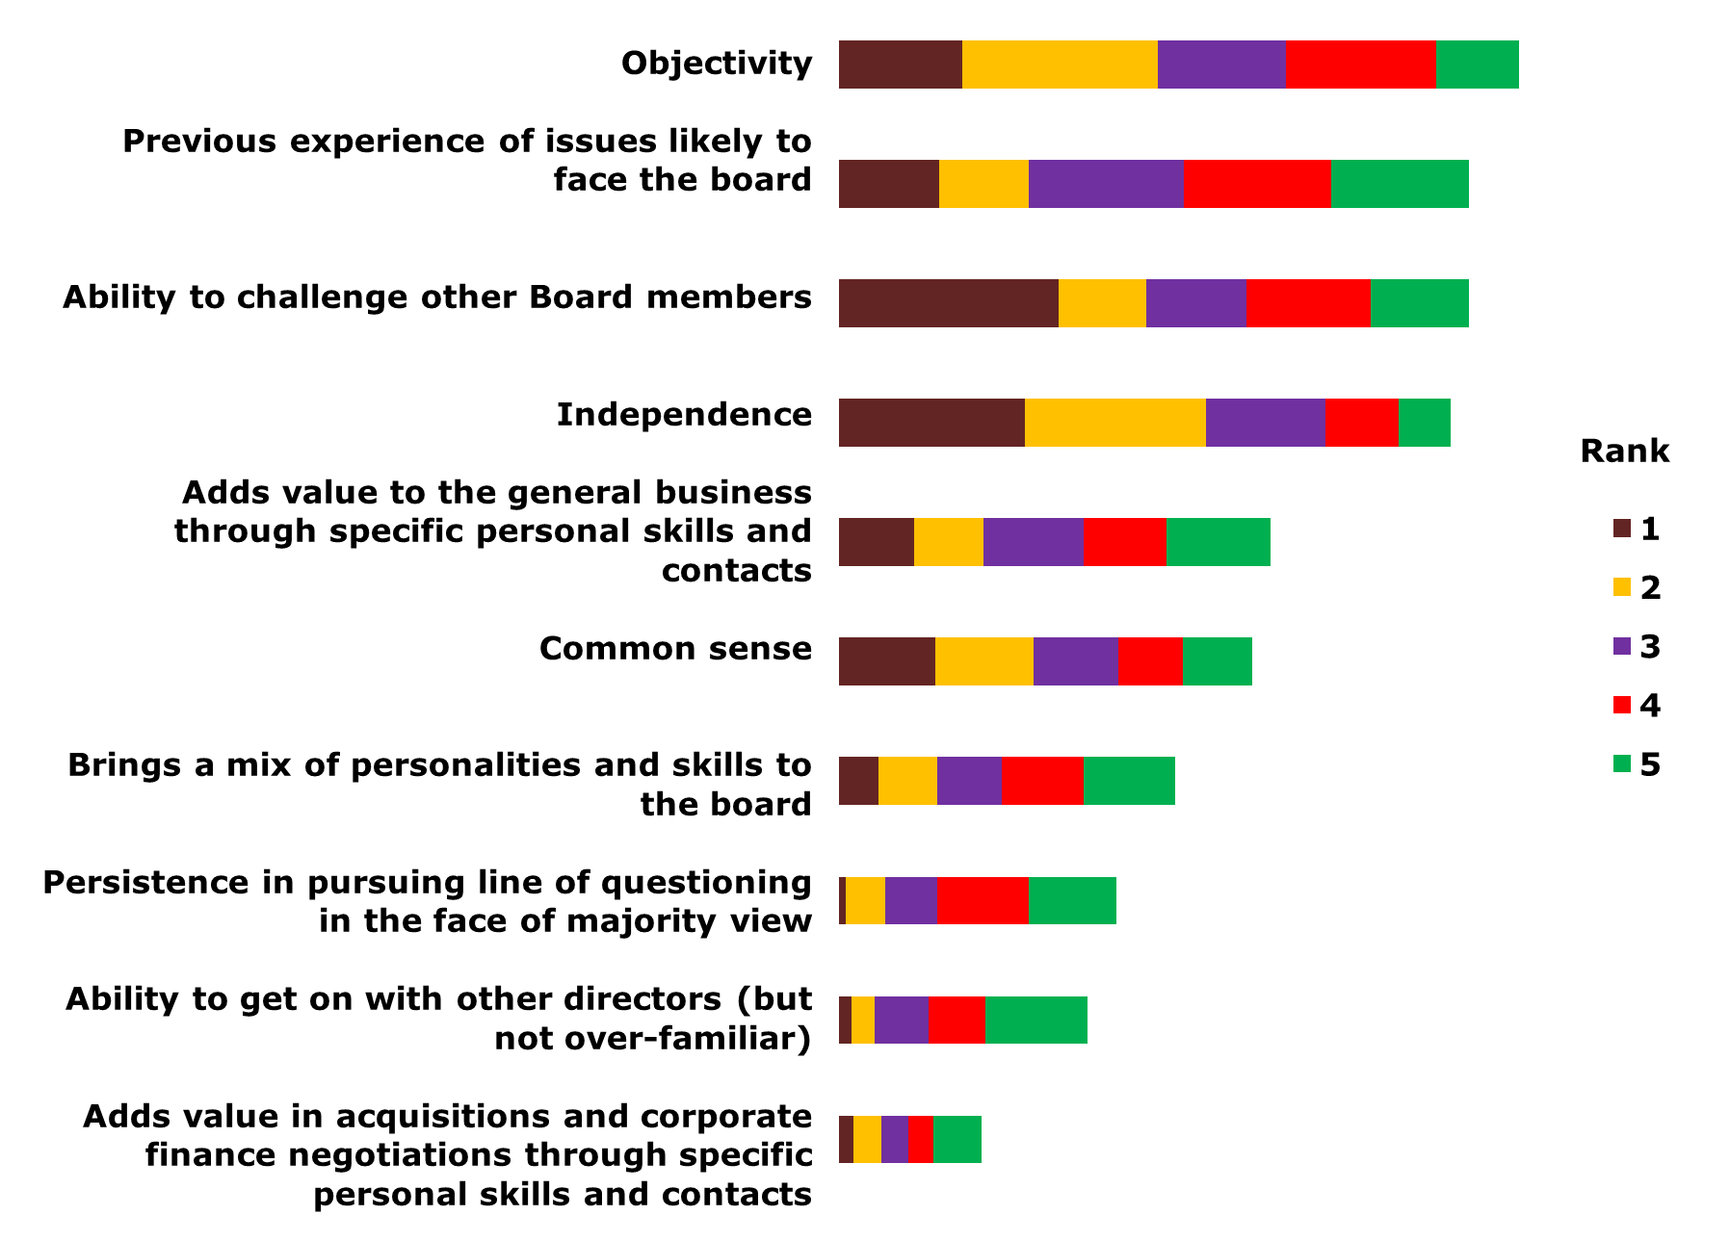
NED skills and behaviours ranked in order of importance
Adding value via specific skills was mentioned by number of respondents, with lower rankings

Slide 22
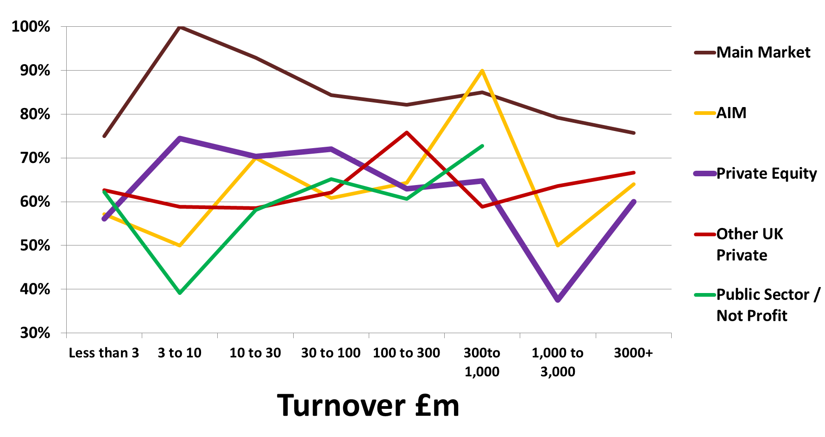
% of respondents stating boards are fully effective

Slide 23
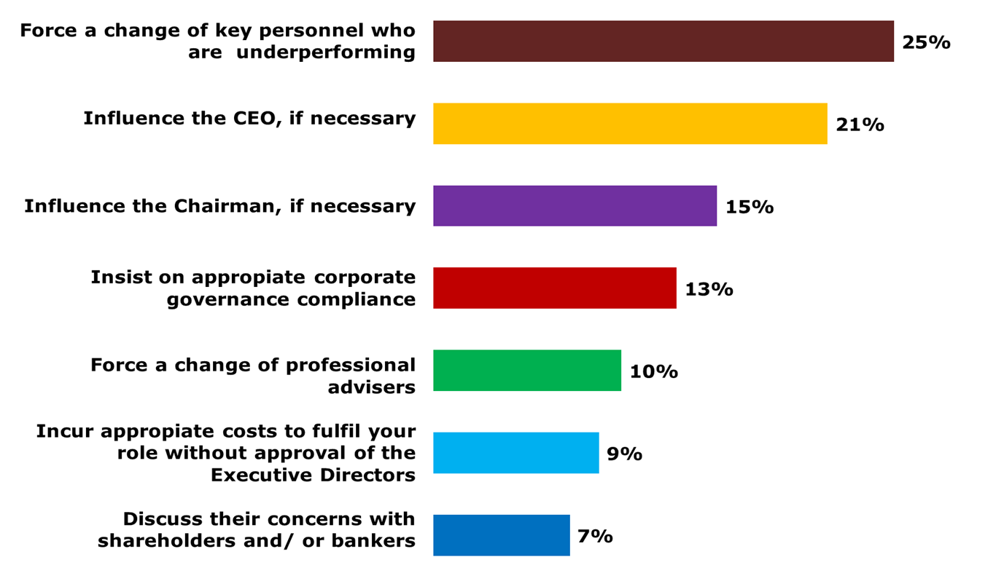
Board Effectiveness: % with concerns about the NEDs ability to:

Slide 24
Culture, Ethics and Morals

Slide 25
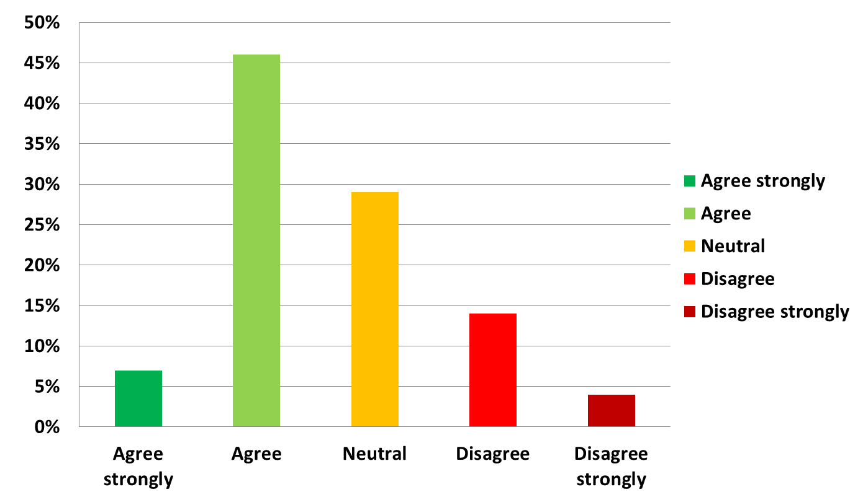
Winning is more important than ethics

Slide 26
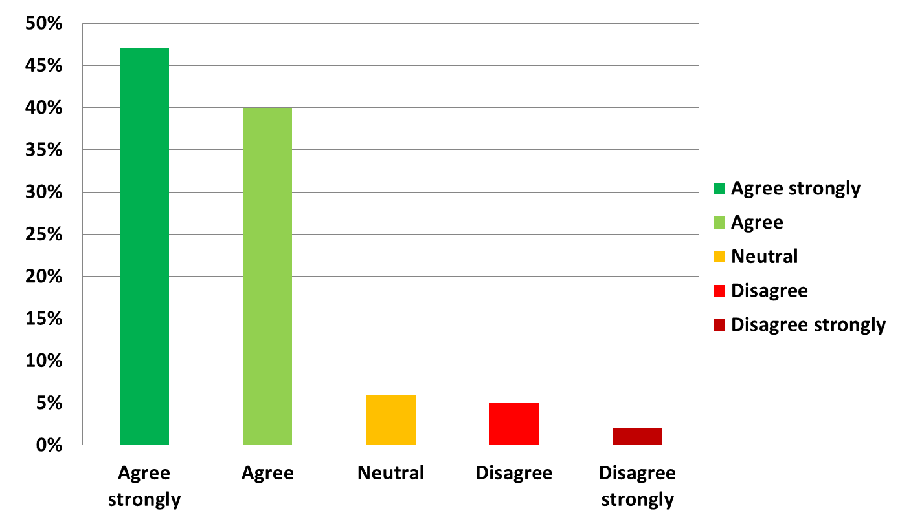
NEDs should influence morality in the boardroom

Slide 27
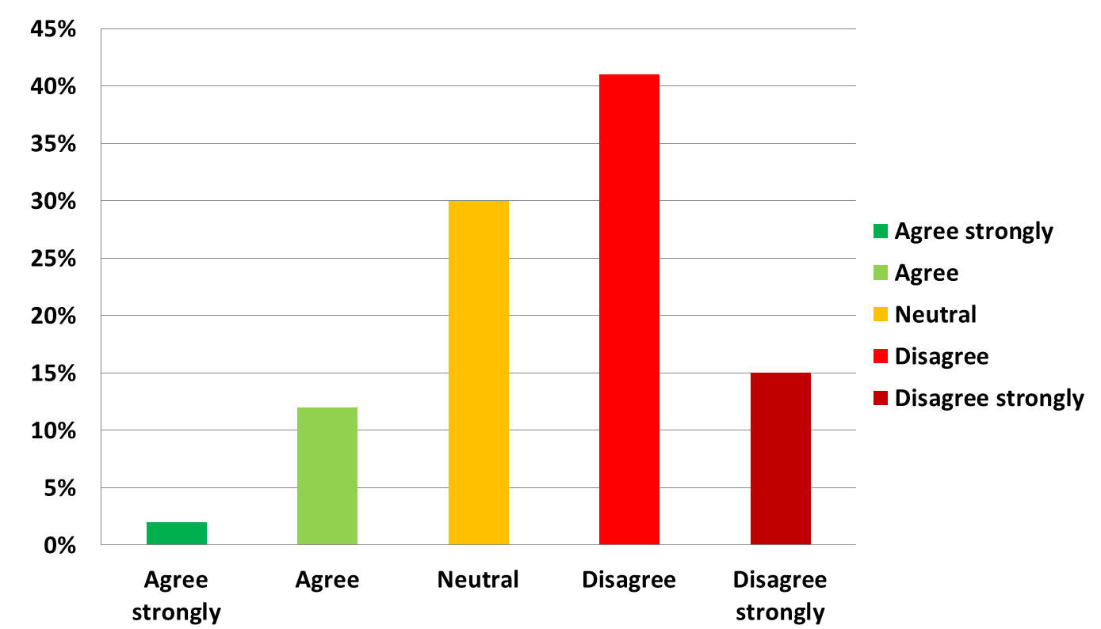
Aggressive corporate tax planning is entirely appropriate behaviour

Slide 28
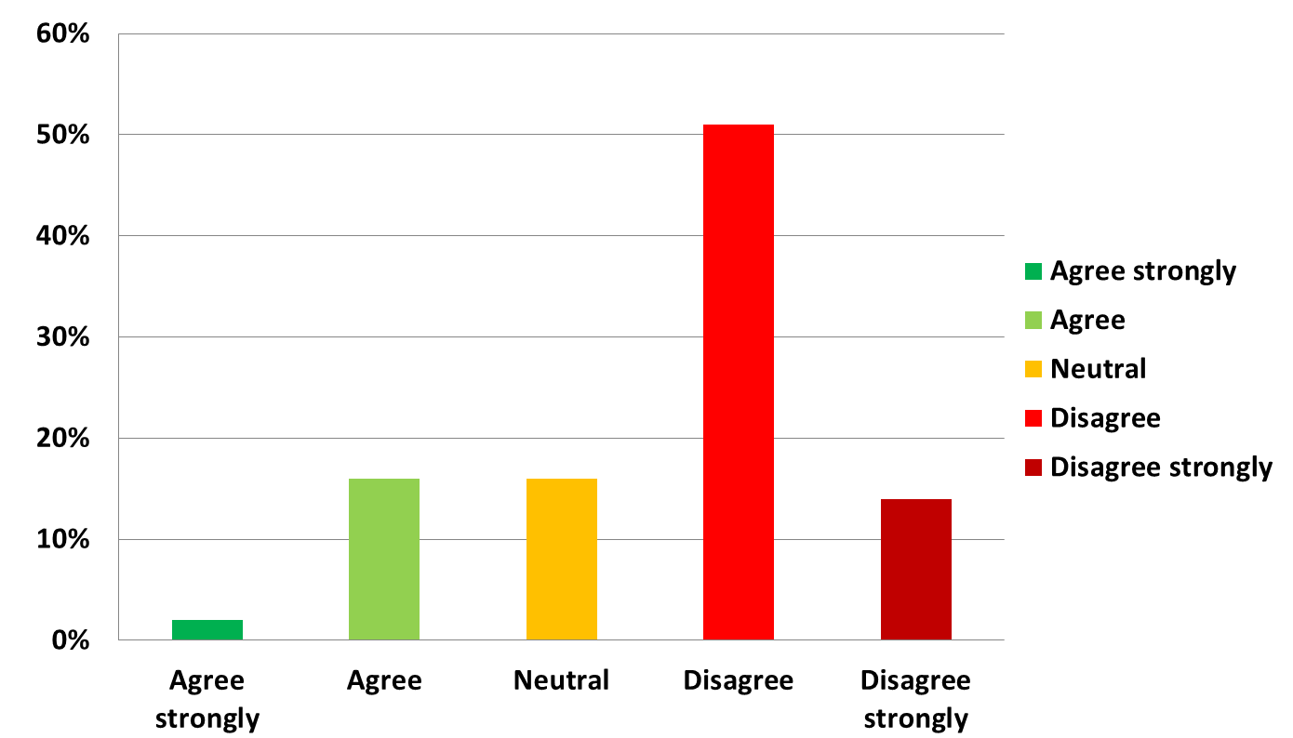
NEDs who are perceived as difficult are side-lined or marginalised

Slide 29
SUMMARY
The Role of the NED is more demanding than ever
Strategy, risk and reputation management are key activities
Exec Remuneration gets a disproportionate share of the spotlight
Plural careers more popular then ever but they’re not for everyone
UK leads the way in Board practice

Slide 30
PANEL Q&A DEBATE:
CHAIRMEN AND NON-EXECUTIVE DIRECTORS’ REMUNERATION
Panel Members:
Deborah Hargreaves, Founding Director,
High Pay Centre
Theresa Wallis, Chairman, LiDCO
NED, Special Products
Cliff Weight,
Director, MM&K
Ken Brotherston, Executive Chairman, Directorbank

